Slide 1


The Role of Sukuk in Development
Presenter: Sheikh Mohamed Issa
CIFCA Coordinator
Shari’ah Advisor Alhuda-CIBE
A CERTIFIED SUKUK PROFESSIONAL

Slide 2

Presentation Outline
Introducing Sukuk
Sukuk’s Potential to Development
Sukuk: A Component of Islamic Capital Markets
The World Bank and Sukuk for Development
African Countries and Sukuk Development
The Needs for Financing in Sub-Saharan Africa
Sukuk Issuances Across Africa

Slide 3
1.0 Introducing Sukuk
According to AAOIFI Investment Sukuk Shari’ah Standard No 17, Sukuk is defined as:
“Certificates of equal value representing undivided shares in ownership of tangible assets, usufruct and services or (in the ownership of) the assets of particular projects or special investment activity”.
Sukuk is a component in Islamic Capital Markets along with Money/ Liquidity Markets, Commodity Markets, Real Estate in Trust etc.

Slide 4
2.0 Sukuk’s Potential to Development
According to UNDP’s paper titled “Financing Agenda 2030” it is written “The potential for Islamic finance to contribute towards financing the SDGs is drawing increasing interest from international development organizations”.
The Islamic finance sector has grown rapidly over the last decade, from US$ 200 billion in 2003 to US$ 2 trillion in 2015 and its assets surpassed US$ 3.24 trillion by 2021.
Moreover, the core principles of Islamic finance align well with those of the 2030 Agenda for Sustainable Development, which seeks to promote inclusiveness, equitable and participatory growth, social and distributive justice, open and accountable institutions and sustainability”.

Slide 5

2.0 Sukuk’s Potential to Development

Slide 6
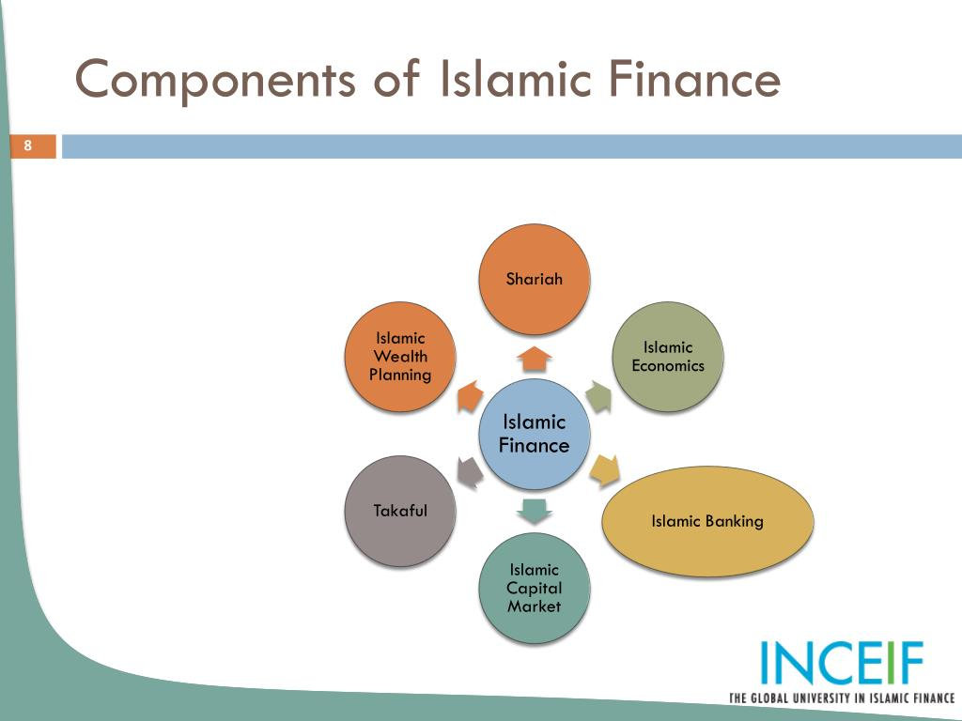
3.0 Sukuk: A Component of Islamic Capital Markets

Slide 7
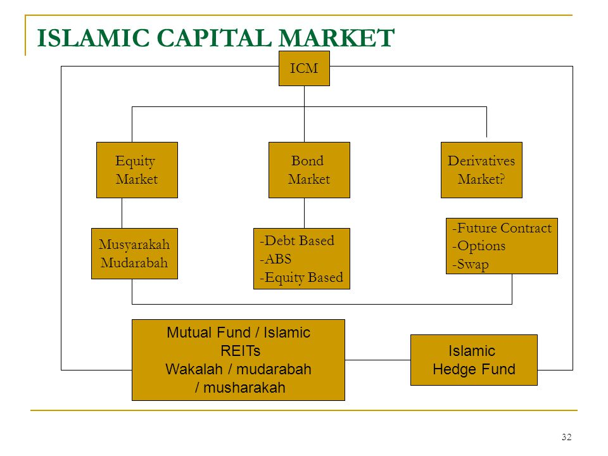
3.0 Sukuk: A Component of Islamic Capital Markets

Slide 8
4.0 The World Bank and Sukuk for Development
According to the world bank again in “The Role of Sukuk in Meeting Global Development Challenges”; “Sukuk market is a way to channel the world’s growing pool of Shari’ah compliant capital to uses that promote sustainable and equitable economic development.
In fact, the underlying tenets of Islamic finance put great emphasis on social justice and social welfare in all economic transactions.
The marriage of Sukuk market with the goal of development and poverty reduction would appear to be a perfect match”

Slide 9
4.0 The World Bank and Sukuk for Development
Hospitals
Renewable Energy
Airports
Railways
Real Estates

Slide 10
4.0 The World Bank and Sukuk for Development

Slide 11
5.0 African Countries and Sukuk for Development
Standard & Poor's estimates that the average fiscal deficit of rated sub-Saharan African sovereigns was 5% of Gross Domestic Product (GDP) in 2016 and just over 4% of GDP (so far) in 2021, compared with an average of 4.6% for 2014 and 2015.
Accordingly, at a time of ongoing fiscal deficits in Sub-Saharan Africa, Sukuk could provide the means for governments across Africa to further diversify their funding sources and focus on domestic funding and domestic projects.

Slide 12
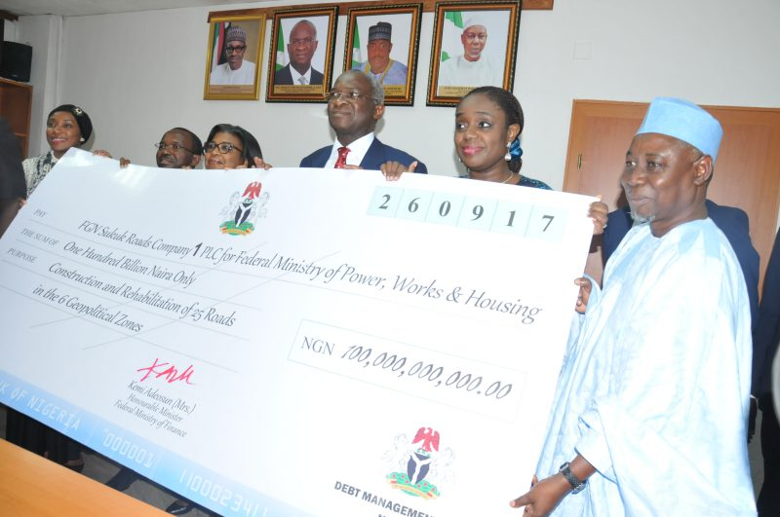


5.0 African Countries and Sukuk for Development
Nigerian government release N100 billion Sukuk Bond for 25 Road Projects - October 2017

Slide 13
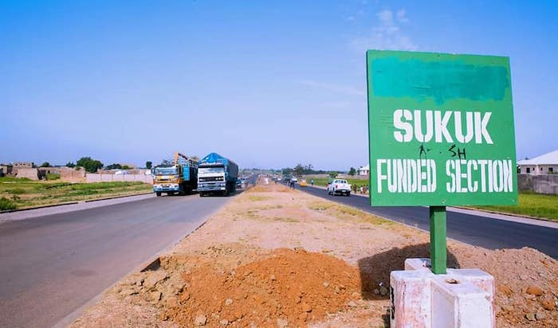
5.0 African Countries and Sukuk for Development
Sukuk Funds Road Infrastructure in Northern Nigeria

Slide 14
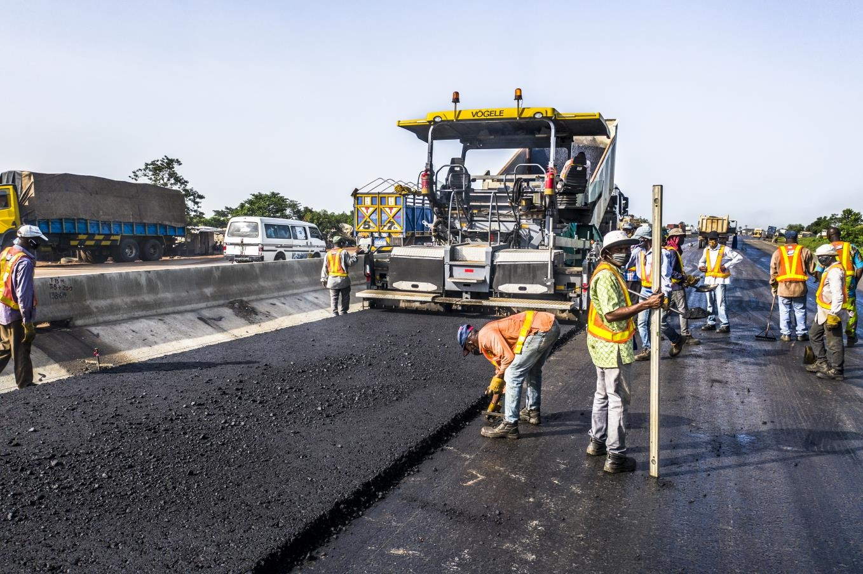
5.0 African Countries and Sukuk for Development
Sukuk financed Road building in Nigeria

Slide 15
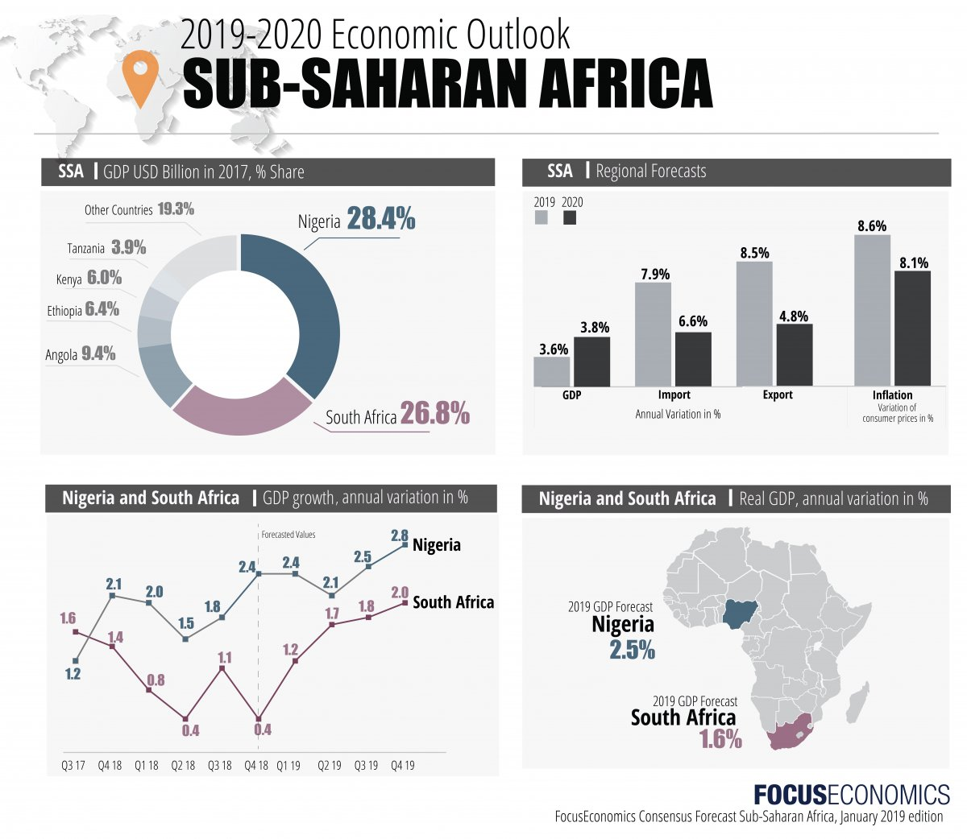
5.0 The Needs for Financing in Sub-Saharan Africa

Slide 16
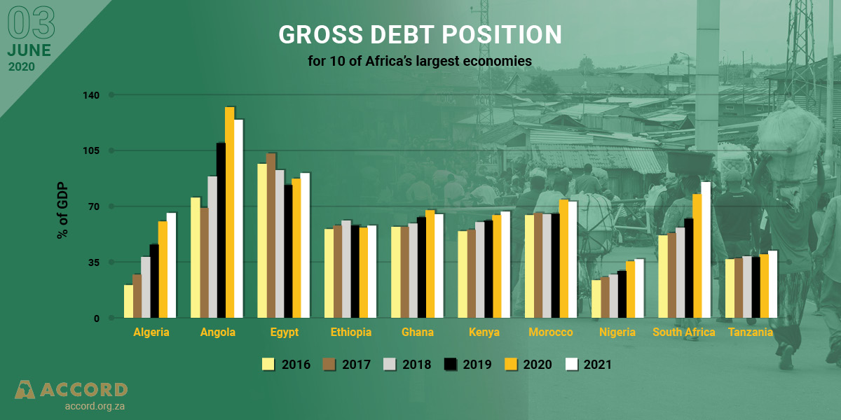
5.0 The Needs for Financing in Sub-Saharan Africa

Slide 17
5.0 The Needs for Financing in Sub-Saharan Africa

Slide 18
RSA USD 500 Ijara Sukuk Structure 2014
5.0 Sukuk Issuance Across Africa
Jobs | Infrastructure | Poverty and Social Wages | Health
Target: to create 11 million new jobs by 2030 Key strategies in place include: Employment tax incentive Industrial support programmes and manufacturing incentives Expanded Public Works Programme Special economic zones to promote exports Support for small, medium and micro enterprises | Public sector investment to total ZAR847.3 billion over the medium term Independent power producers programme diversifying out of renewables into: gas; hydro; coal; and cross border projects Medupi and Kusile power stations construction underway Transnet to upgrade coal, iron ore and manganese rail lines whilst 29 large bulk water schemes are under construction The new bus rapid transit system will be constructed in nine cities | Community works programme to be established in every municipality Support for smallholder farmers, rural employment programmes and land restitution | More than ZAR21 billion allocated to build, refurbish and maintain health related infrastructure Two National Health Insurance conditional grants will support contracting doctors and pilot health service innovations in 10 districts Health professions training and development grant will boost the number of health professionals in the public health sector Recruit, train and deploy between 700 000 and 1.3 million community health workers to implement community-based health care

Slide 19
RSA USD 500 Ijara Sukuk Structure 2014
5.0 Sukuk Issuance Across Africa
REPUBLIC OF SOUTH AFRICA
(as Seller)
REPUBLIC OF SOUTH AFRICA
(as Lessee)
REPUBLIC OF SOUTH AFRICA
(as Servicing Agent)
REPUBLIC OF SOUTH AFRICA
(as Obligor)
Sells assets
Purchase price for assets
Lease assets
Rental Payments
Services
Service Charge Amount
Repurchase of assets
Sale & Purchase undertaking
RSA TRUST
(Issuer / Trustee / Lessor)
Exercise Price
Issue of Certificates
Proceeds of issue
Periodic Distribution Amounts
Dissolution Amounts
Certificate holders
Asset movement / obligations
Source: National Treasury
Cash flow

Slide 20

5.0 Sukuk Issuance Across Africa

Slide 21
Republic of Senegal Sukuk: Ijara Sukuk
5.0 Sukuk Issuance Across Africa

Slide 22
5.0 Sukuk Issuance Across Africa

Slide 23
5.0 Sukuk Issuance Across Africa
Dissolution
Amounts

Slide 24
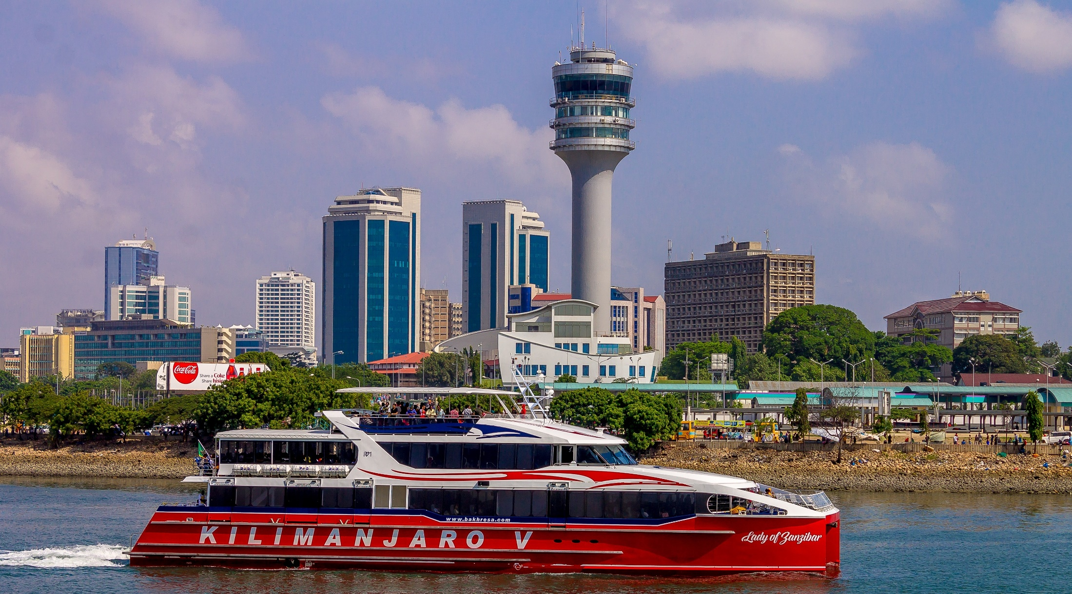
Tanzania

Slide 25



Slide 26
جزاكم الله خيرا

